Slide 1
Brahe, Kepler, Mars, Ellipses & Gravity
Perhaps the oldest, (very) non-trivial data analytics example

Slide 2
Questions
What trajectory does a planet move in?
Can these trajectories be obtained from “simple” observations?
What physical law explains these trajectories?
What has data analysis got to do with all this?
How was this analysis done ~400 years ago (1580-1610)?

Slide 3
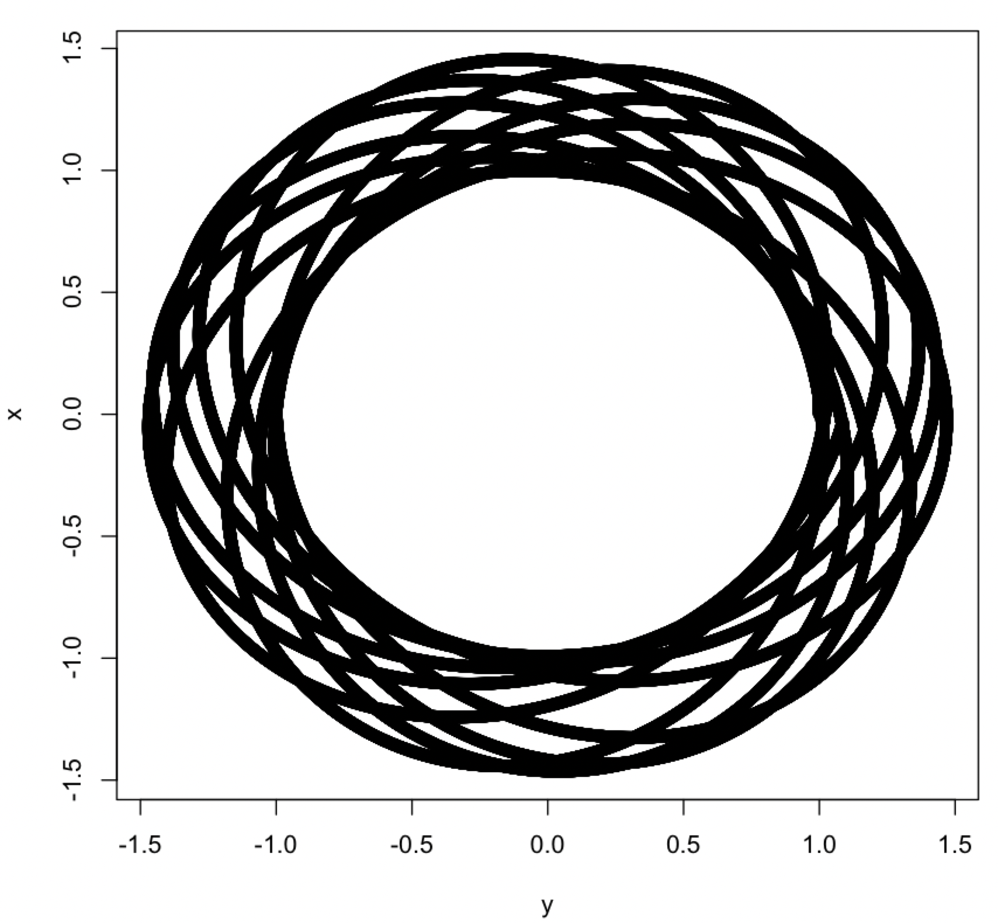
A Strange Trajectory
Could planets move in such a trajectory? How would one know?

Slide 4
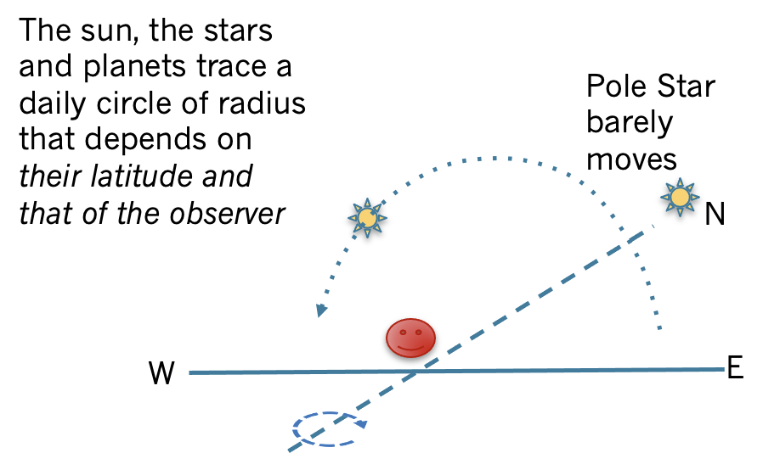
Observing Objects in the Sky
How do we remove the confounding effects of the Earth’s rotation?

Slide 5
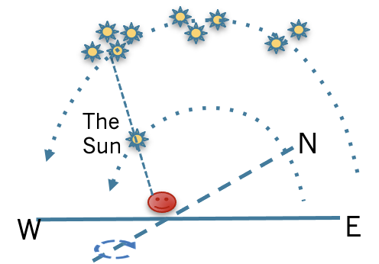
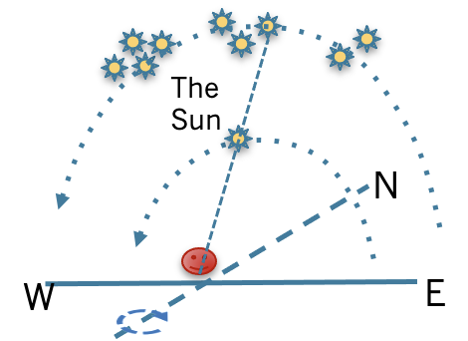
Observing Objects in the Sky
Which star lies behind? And how does that change as the months progress? The simple periodicity of ~365 days is easy to see

Slide 6
Questions
The Sun is bright; how does one observe the star behind it?
Use the rising/setting trick
But requires making observations at the horizon

Slide 7
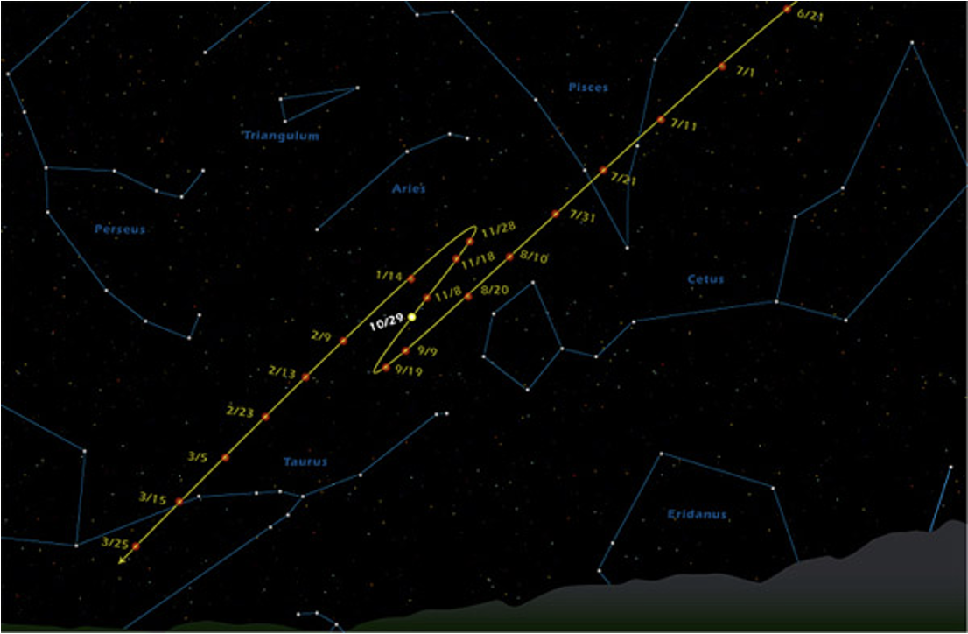
Mars’ Eerie Zig-Zag
Mars moves in a strange zig-zag? Why?

Slide 8
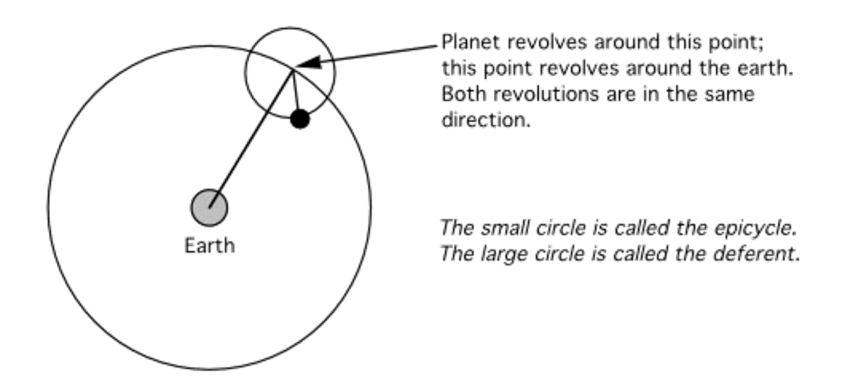
A Complex Explanation
Could this epicyclic model be the right model for Mars?

Slide 9
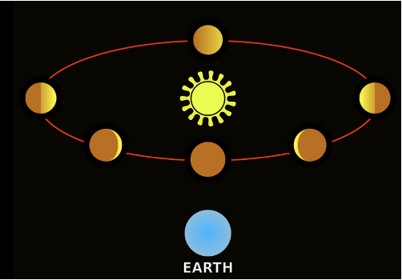
The Phases of Venus
Full Venus is smaller than its crescent version! Why?

Slide 10
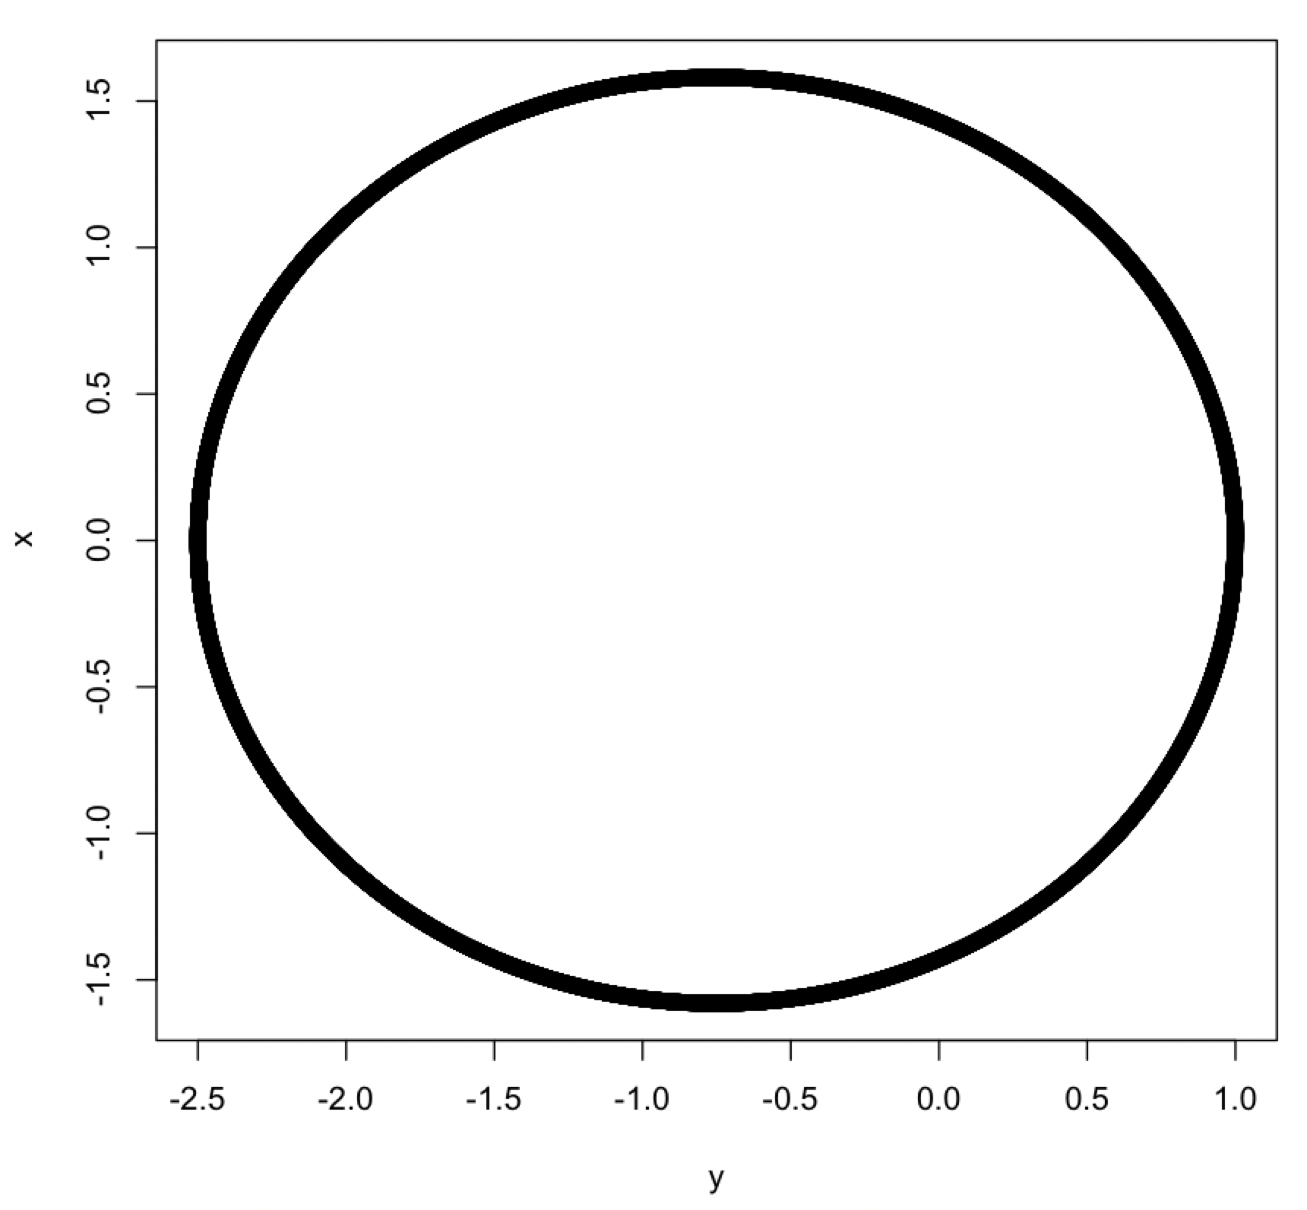
A More Likely Trajectory
A simple closed curve, perhaps a circle, around the Sun?

Slide 11
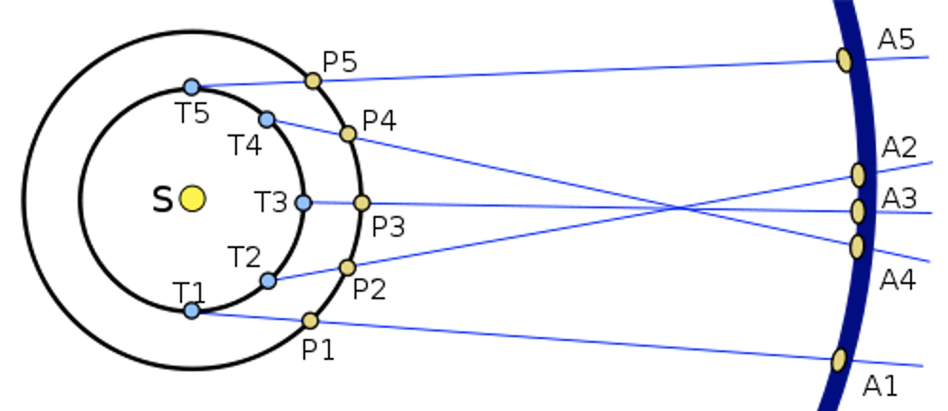
Why the Zig-Zag?
Heliocentric models explain Mars’ zig zag

Slide 12
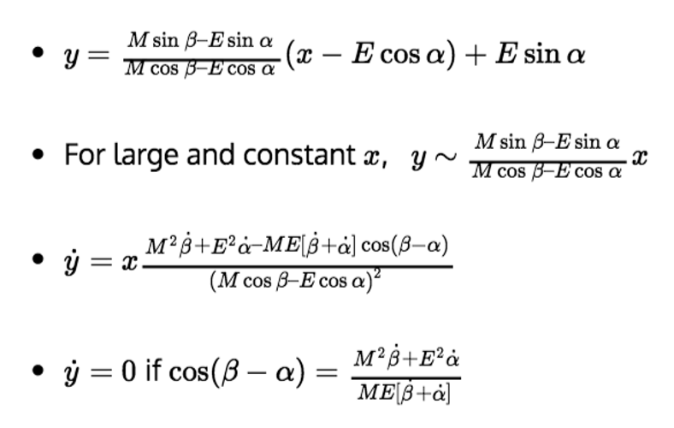
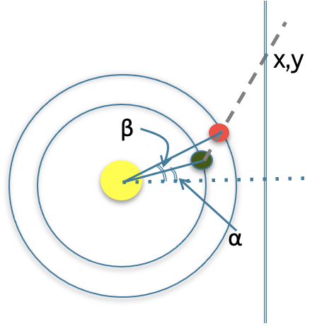
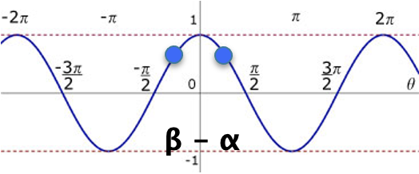
Explaining the Zig Zag
The derivative is 0 when β-ɑ is close to 0; hence the zig-zag happens close to an Opposition (all three in a straight line)

Slide 13
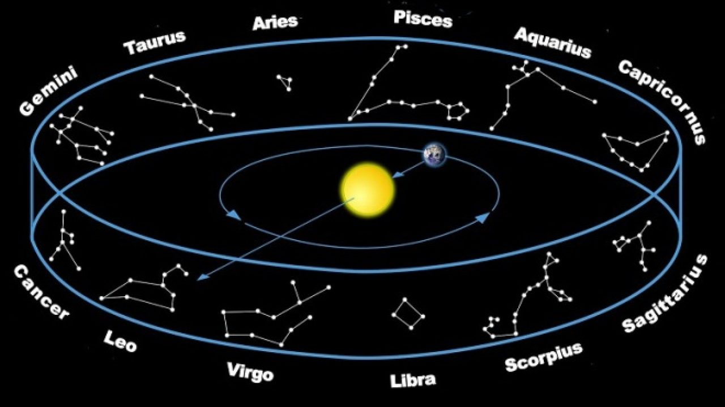
The Zodiac
The stars that lie behind the Sun form the Zodiac; the plane on which the Earth and Sun lie is the Ecliptic

Slide 14
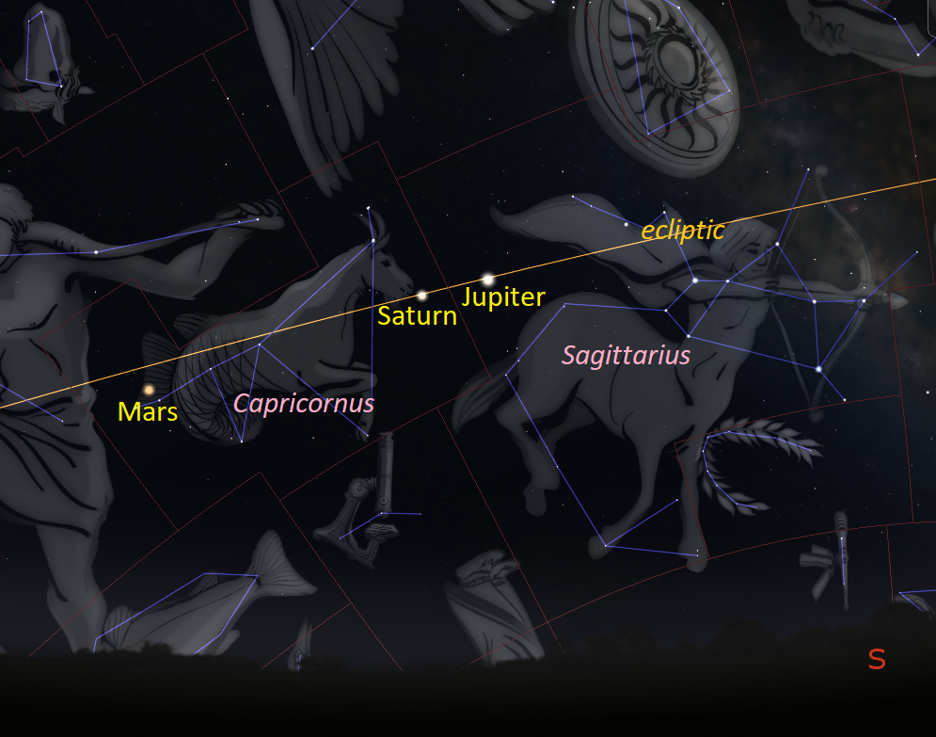
The Zodiac
Most planets stay very close to the Ecliptic. Mars’ orbit is only slightly inclined relative to the Ecliptic plane.

Slide 15
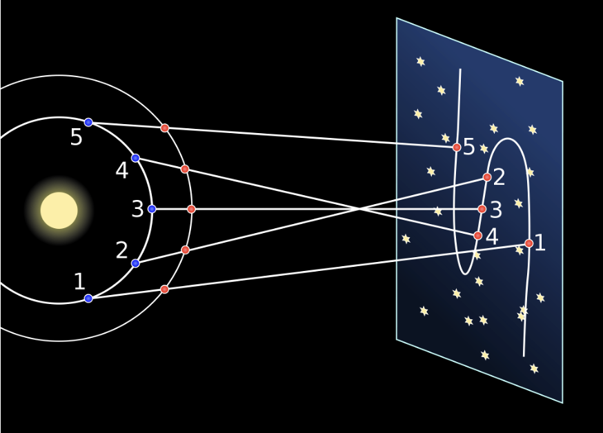
Slight Non-Coplanarity
Mars’ orbit is not coplanar with the ecliptic plane, though only slightly so; that explains the shift in the zig-zag

Slide 16
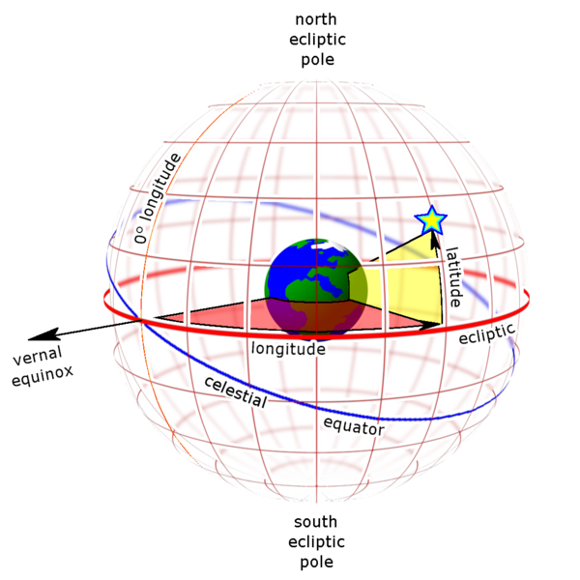
Calibrating Movement
Longitude: Angle along the Ecliptic relative to a zero point (for now arbitrarily assigned, though the spring equinox point was often the conventional zero)
Latitude: drop a perpendicular to the ecliptic and measure the angle between the planet and the ecliptic

Slide 17
Longitude
0

Slide 18
Latitude
0

Slide 19
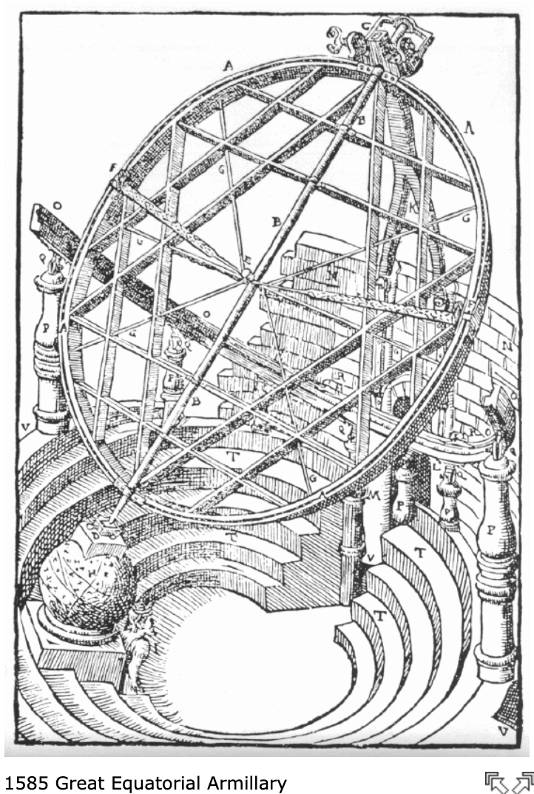
Tycho Brahe
Master observer, created a series of instruments to make latitude and longitude measurements precise
Error: mostly <2’ of an arc, occasionally 4’
Observed Mars religiously from 1580-1601 when he died
Kepler obtained the data post his death and spent the next several years in its analysis

Slide 20
Accuracy of Tycho Brahe’s Measurements
(from his Wikipedia article)
He aspired to a level of accuracy in his estimated positions of celestial bodies of being consistently within an arcminute of their real celestial locations, and also claimed to have achieved this level. But, in fact, many of the stellar positions in his star catalogues were less accurate than that. The median errors for the stellar positions in his final published catalog were about 1.5', indicating that only half of the entries were more accurate than that, with an overall mean error in each coordinate of around 2'.[76] Although the stellar observations as recorded in his observational logs were more accurate, varying from 32.3" to 48.8" for different instruments,[77] systematic errors of as much as 3' were introduced into some of the stellar positions Tycho published in his star catalog — due, for instance, to his application of an erroneous ancient value of parallax and his neglect of polestar refraction.[78] Incorrect transcription in the final published star catalogue, by scribes in Tycho's employ, was the source of even larger errors, sometimes by many degrees.[c]
Celestial objects observed near the horizon and above appear with a greater altitude than the real one, due to atmospheric refraction, and one of Tycho's most important innovations was that he worked out and published the very first tables for the systematic correction of this possible source of error. But, as advanced as they were, they attributed no refraction whatever above 45° altitude for solar refraction, and none for starlight above 20° altitude.[82]

Slide 21
The Data
Only some parts of this data are easily accessible though
Over 20 years of observations, with the following for each observation
Time
Geocentric Longitudes
Geocentric Latitudes
With an accuracy largely of ~2’ with the occasional observation being off by ~4’
After corrections for optics etc

Slide 22
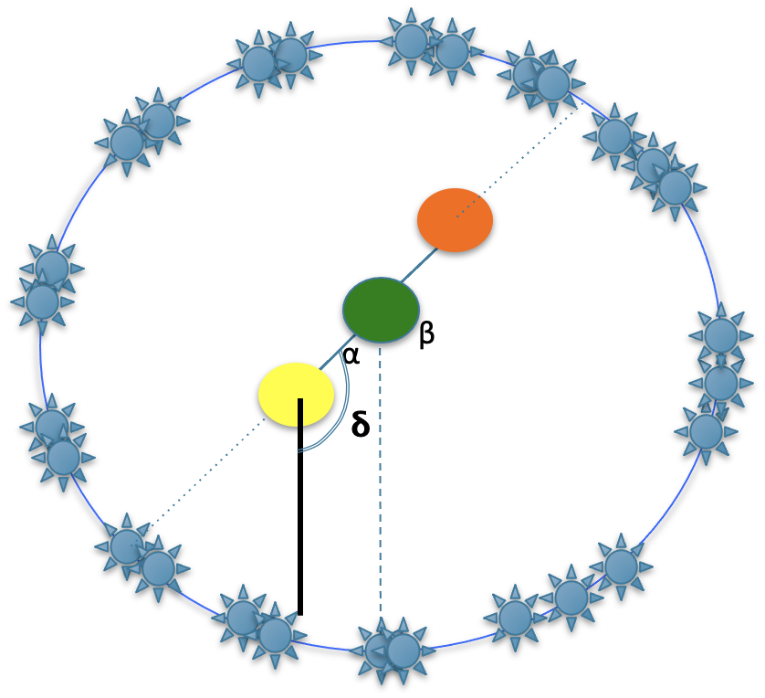
Oppositions
Time, latitude and longitude for 12 oppositions is accessible
If Mars goes around the Sun
Then it is useful to deal with Heliocentric longitudes (𝛅 ) than with Geocentric longitudes (β)
However, one can only measure Geocentric longitudes
But at oppositions, both longitudes are identical

Slide 23
The Oppositions Data
Time, heliocentric longitude and geocentric latitude for 12 oppositions
Time [Year, Mon, Day, Hour, Min] [[1580,11,18,1,31],[1582,12,28,3,58],[1585,1,30,19,14],[1587,3,6,7,23],[1589,4,14,6,23],[1591,6,8,7,43],[1593,8,25,17,27],[1595,10,31,0,39],[1597,12,13,15,44],[1600,1,18,14,2],[1602,2,20,14,13],[1604,3,28,16,23]]
intervals = [1108947, 1101076, 1100889, 1108740, 1130480, 1165544, 1146672, 1115465, 1102938, 1100171, 1104610] #in minutes, between successive records
Latitudes [Deg, Min, N or s] [[1,40,'N'],[4,6,'N'],[4,32,'N'],[3,41,'N'],[1,12,'N'],[4,0,'S'],[6,2,'S'],[0,8,'N'],[3,33,'N'],[4,30, 'N'],[4,10, 'N'],[2,26,'N']]
Longitudes [Deg, Min, Sec, Zodiac 30° Band]
[[6,28,35,2], [16,55,30,3], [21,36,10,4], [25,43,0,5], [4,23,0,7], [26,43,0,8], [12,16,0,11], [17,31,40,1], [2,28,0,3], [8,38,0,4], [12,27,0,5], [18,37,10,6]]

Slide 24
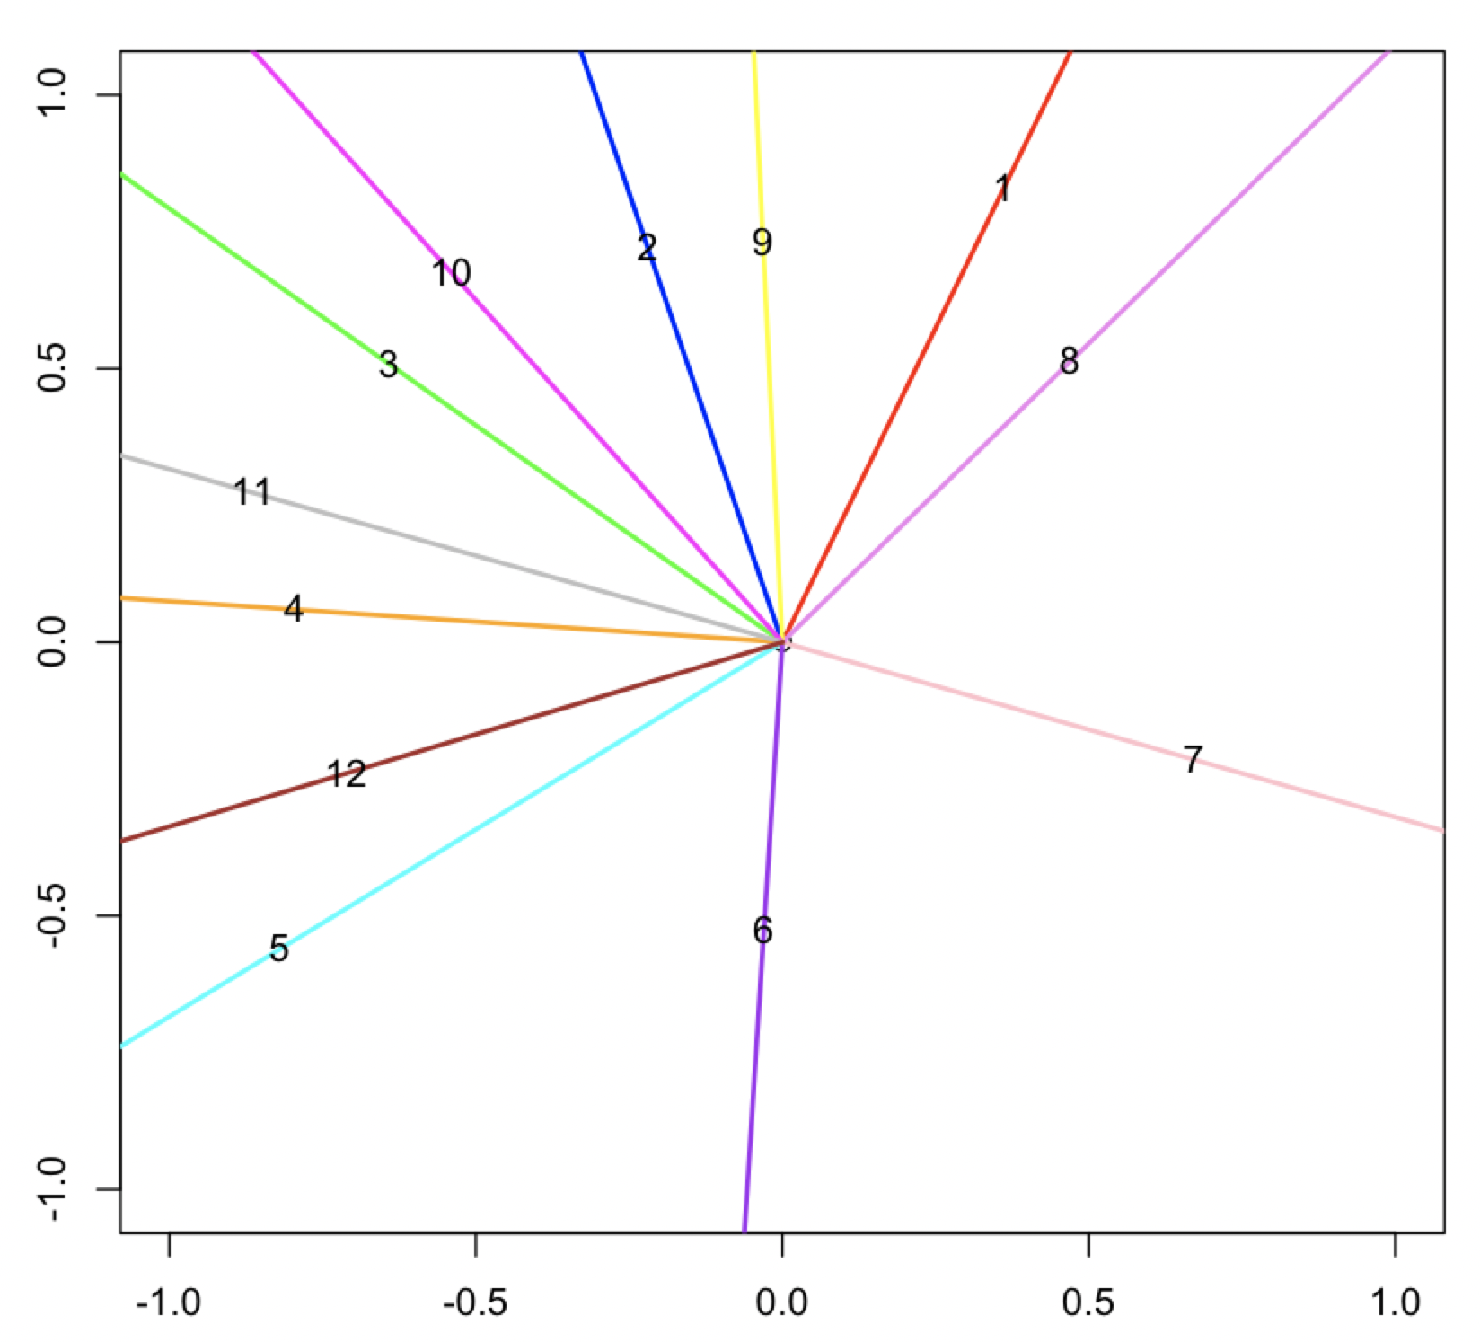
Longitudes from the Oppositions Data
The Sun is taken as the fixed center here; the +ve x axis is the zero longitude. Where on these lines is Mars?

Slide 25
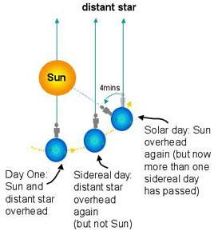
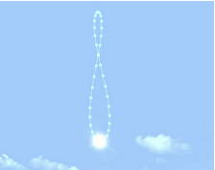
Cadence
Uniform speed? Or not?
Earth is faster in Dec-Jan, slower in Jun-Jul!
The Analemma (plot the Sun in the sky at noon everyday)
How about Mars?

Slide 26
Perhaps an Off Center Sun
Uniform angular speed about the center implies varying angular speed about the Sun.
Sun appears to move slower
Sun appears to move faster

Slide 27
The Imaginary Equant Hypothesis
Uniform angular speed not around the center of the circle but around some other unknown point
Sun appears to move slower
Sun appears to move faster

Slide 28
Orbit Time Periods
How do we determine the time taken by Mars to go around its orbit once?
Geocentric observations confound periodicity
Use latitudes
Latitude 0 is easily observable from the Earth
Happens twice in each orbit
The period as calculated from Brahe’s observations turns out to be ~687 days
With enough observations, this can be pinned down more precisely as well, which is what Kepler did
For our analysis, since we are using only a subset of the data, we will treat it as an unknown parameter to be estimated, since we need precision
We will assume periodicity though (i.e, each round around the orbit takes the same amount of time)

Slide 29
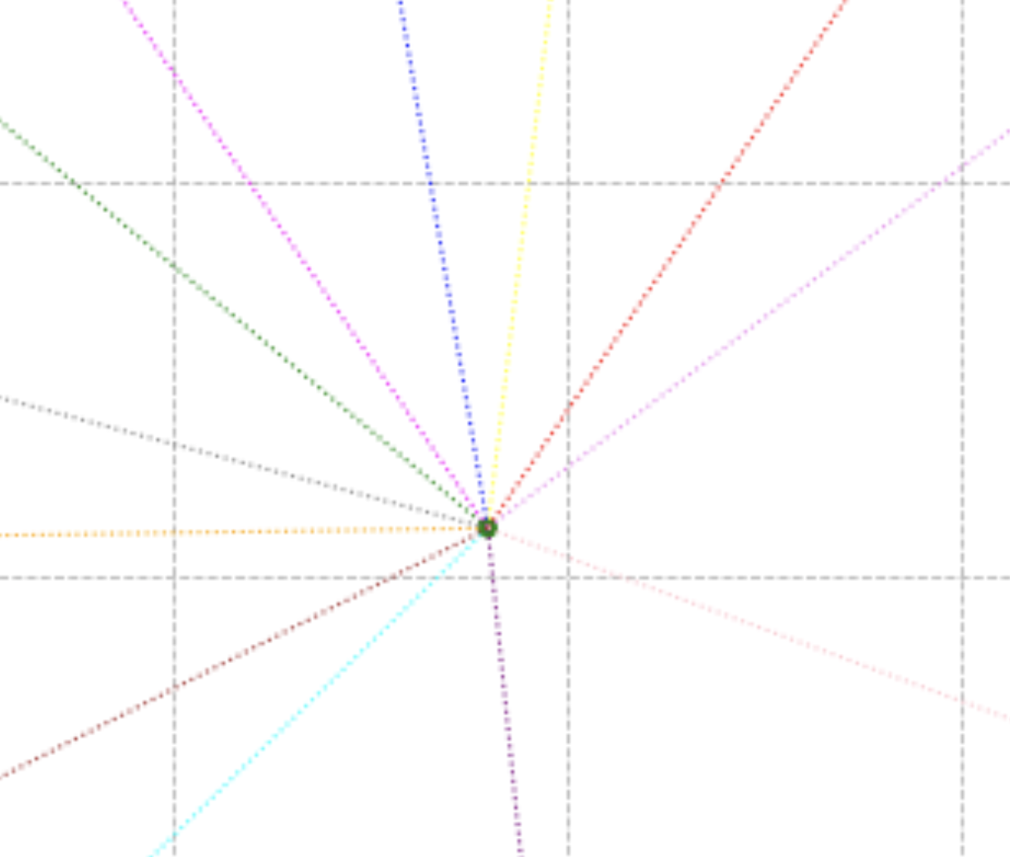
Using the Equant
Each dotted line points towards Mars’ position at the time of the resp opposition. Time intervals between oppositions provide the angles between the dotted lines, centered at the Equant.
The angle between these two is (time interval between the two oppositions/total orbit time * 360)

Slide 30
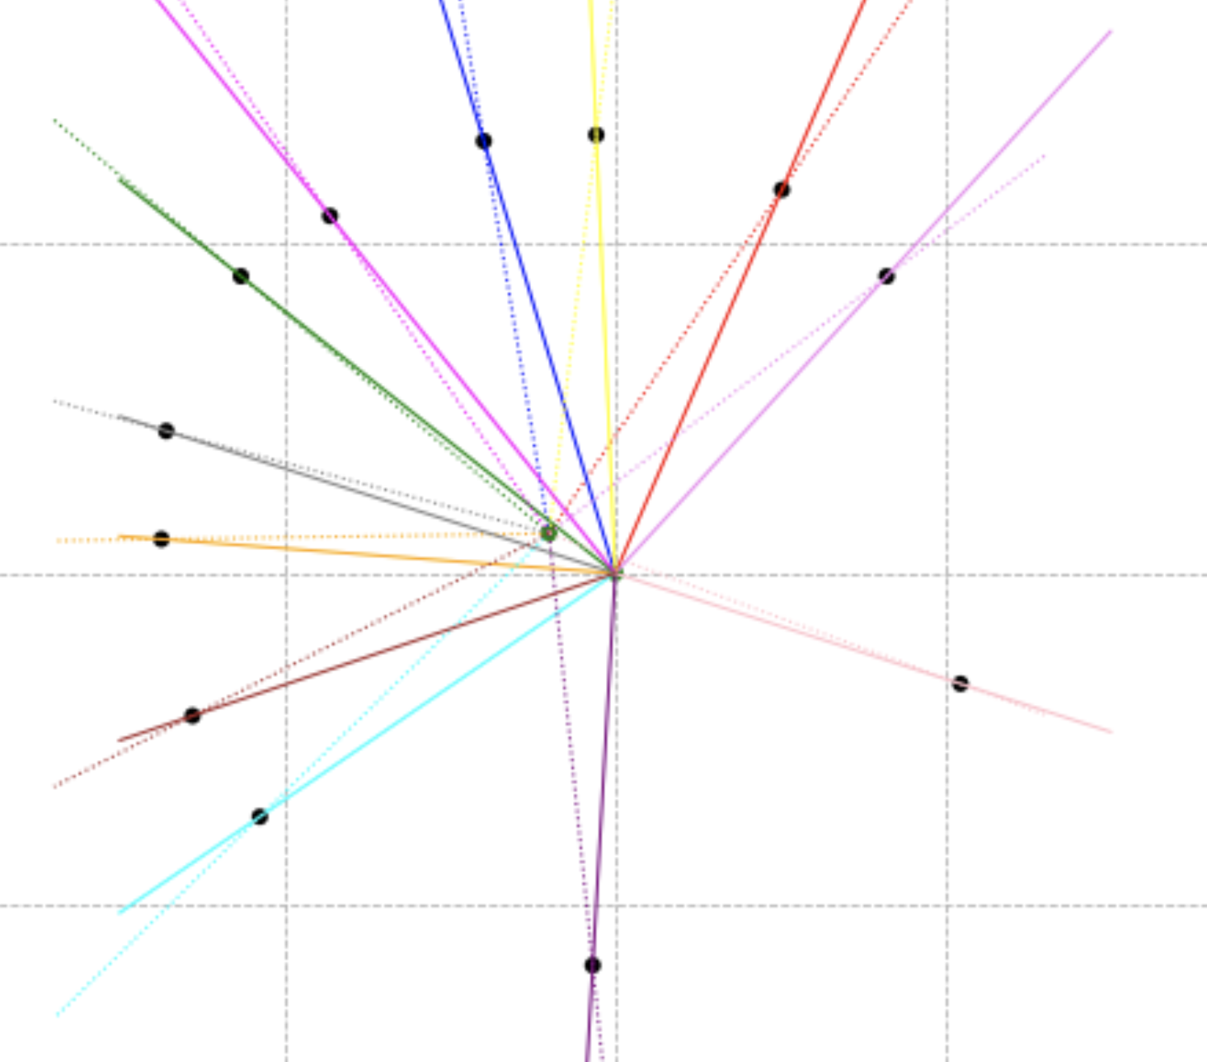
Equant Longitudes
Optimize over all possible Equant positions and rotations of the dotted line system so the black dots lie as close to a circle as possible
The position of the Equant and the rotation of the the system of dotted lines around the Equant are unknowns. Once fixed, we get a set of dotted line directions that are called Equant longitudes
The intersections of the resp dotted and solid lines yield the positions of Mars (black dots)

Slide 31
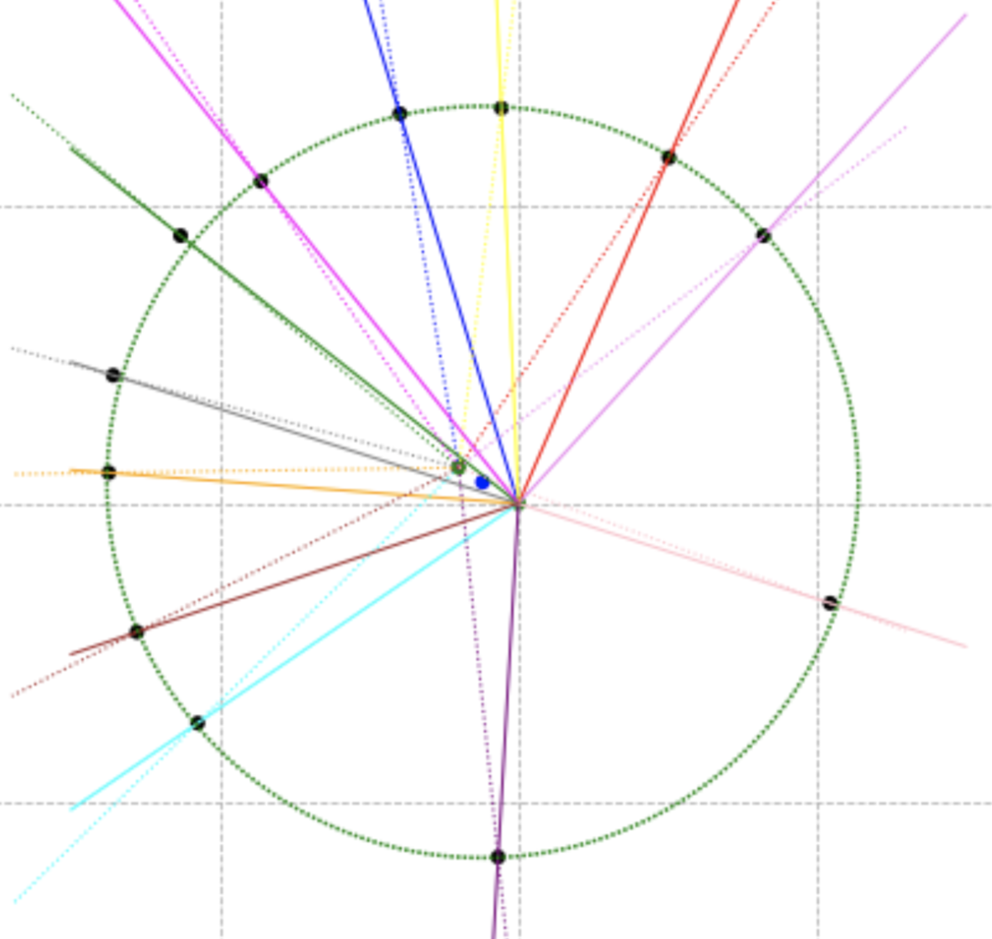
Fitting an Orbit
The Circle fit to the black dots makes for a close but not a perfect fit. The center (blue dot) is in between the Sun and the Equant. What is the right goodness of fit measure?
Longitude 0: Aries
Line connecting Equant & Sun
~328°

Slide 32
Defining the Goodness of Fit
This discrepancy should be less than the error in each observation for the orbit model to be acceptable.
Given an orbit model
Say a circle
With a specified center and radius (relative to a fixed Sun)
And a specified Equant
And a specified direction for the Equant 0 longitude
And a specified orbit time period
What is the discrepancy between the model and the observation?
The orbit model predicts a position on the orbit for each opposition
The heliocentric longitude observations indicate another position on the orbit for each opposition
If these two positions coincide for all observations, then our orbit model is perfect
If not, then we have some discrepancy

Slide 33
Goodness of Fit: Opposition Discrepancy
If 𝜹<4’ then there exists an position of the Earth so the longitudes measured from the Earth for the Sun and for Mars are within 4’ of the actual resp observations, which is within the range of observational error
𝜹

Slide 34
The Problem, then..
Circular Orbit for Mars, with arbitrary center (c) and radius (r)
Uniform angular speed (s) for Mars around an arbitrary Equant (e)
The zero of the Equant longitudes (z)
Determine c, e, z, s, r so as the minimize the max Oppositions Discrepancy
What is the value of this discrepancy?

Slide 35
How do you optimize?
Determine c, e, z, s, r so as the minimize the max Oppositions Discrepancy
c: just one parameter (the angle)
e: two parameters (angle and distance from the Sun)
z: one parameter (angle)
Do a discretized exhaustive search over these 4 parameters
That leaves s and r on the inner loop
For s, do a discretized search in the neighborhood of 687 days
For r, do a discretized search in the neighborhood of the average distance of the black dots from the center
A binary search might also work for the two parameters above, given likely single local minimum
Inside the innermost loop, compute the discrepancy for each opposition

Slide 36
Fitting an Orbit
With a circular orbit with center between the Sun and the Equant, the discrepancies are
[2.2365144524494895, -3.2120110368510866, -3.5669725653222106, -1.06042215541062, -3.6399623095565166, -2.1601790100240748, 2.980086019452943, 3.6599934592104133, 0.8100027563293606, 0.22279241557410429, 3.2673586389416465, 1.8050469915310428]
Longitude 0: Aries
Line connecting Equant & Sun
~328°

Slide 37
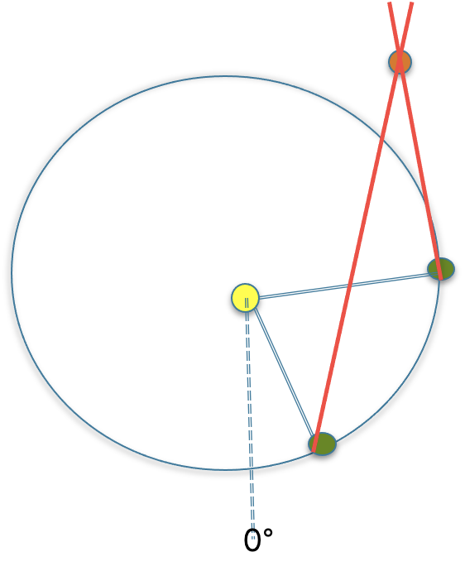
What is the Radius of this Circle?
The distance between the Earth and the Sun is assumed to be 1 AU (of course, this assumes Earth’s orbit is a circle with the Sun at the center, otherwise 1AU will have to be redefined appropriately)
We can only measure angles; then how do we get distances?
The triangulation trick
The time period is T=~687 Earth days (Kepler would have used a more precise value)
Then take pairs of observations, the two in a pair being T apart in time.
The Earth varies between the two observations in a pair, but Mars stays the same
As earlier, you have geocentric longitudes for the Sun and for Mars

Slide 38
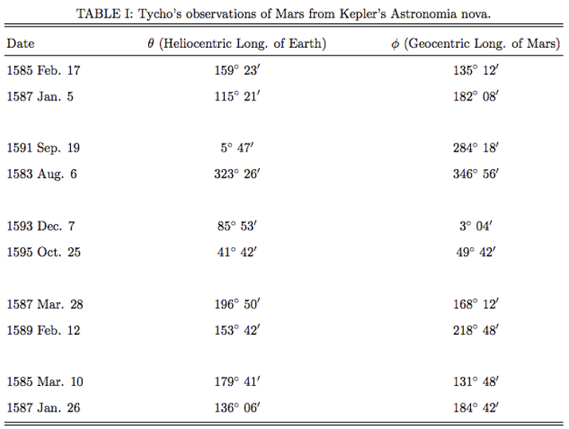
The Triangulations Data
While we have only dates in this picture, Tycho Brahe’s observations are likely to have had the hour and min as well
http://faculty.a.edu/saustin/3110/mars.pdf
[Heliocentric Longitude of Earth, Geocentric Longitude of Mars each in Deg, Min]
[159,23,135,12] and [115,21,182,8]
[5, 47, 284, 18] and [323, 26, 346, 56]
[85, 53, 3, 4] and [41, 42, 49, 42]
[196, 50, 168, 12] and [153, 42, 218, 48]
[179, 41, 131, 48] and [136, 6, 184, 42]

Slide 39
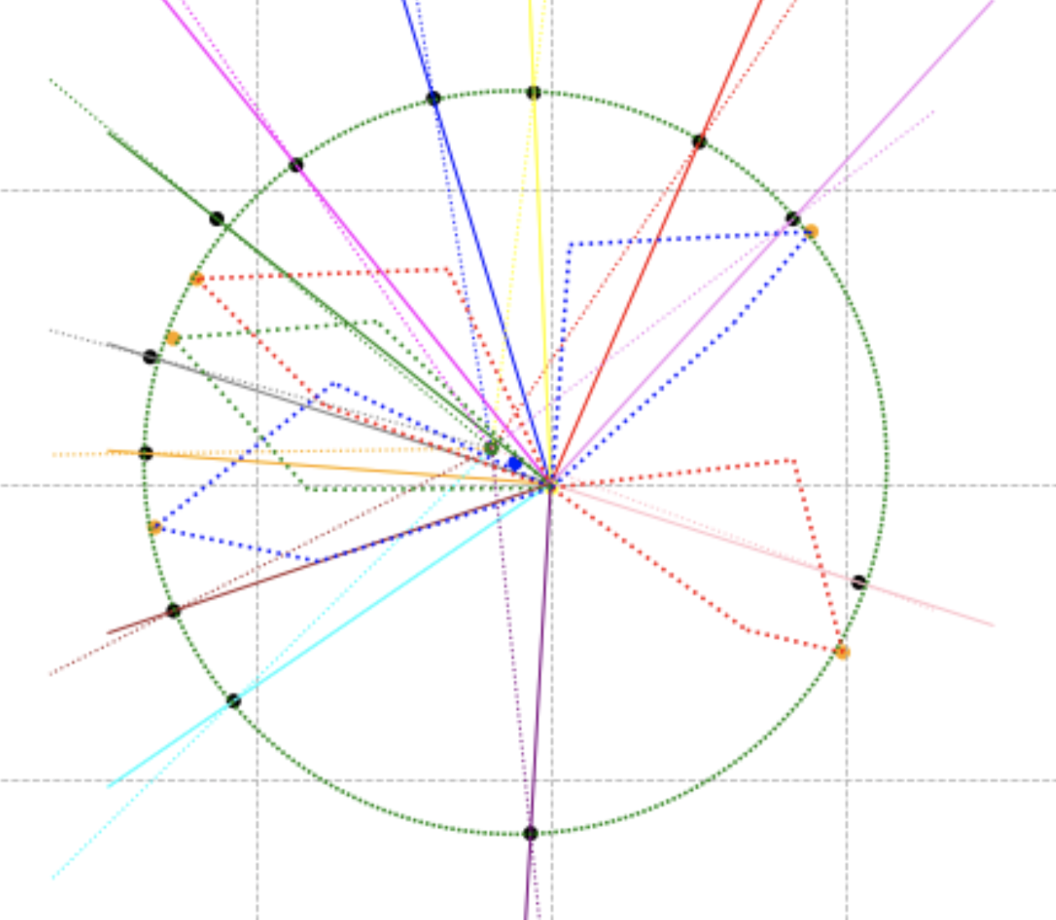
Superimposing Triangulations
Assuming the Earth has a circular orbit centered at the Sun, scale the radius of this orbit appropriately so the triangulation positions of Mars come close to the circular orbit for Mars. The radius of Mars’ circle is ~1.5x of Earth’s circle.

Slide 40
Triangulations Discrepancy
How much do we need to tweak each of the 4 angles here so Mars lies on the proposed orbit? If that is within 4’ each then the proposed orbit is consistent with the observations, up to the observational error of 4’ per angle

Slide 41
The Problem, then..
Circular Orbit for Mars, with arbitrary center (c) and radius (r)
Circular Orbit for Earth, centered at the Sun with radius 1AU
Uniform angular speed (s) for Mars around an arbitrary Equant (e)
The zero of the Equant longitudes (z)
Determine c, e, z, s, r so as the minimize the max Oppositions Discrepancy and Triangulations DIscrepancy
What is the value of this discrepancy?
Just a bit too large given the accuracy of Tycho Brahe’s observations (but not way way off either, so at least some of the parameters are in the neighborhood)
So one or more assumptions above is not true

Slide 42
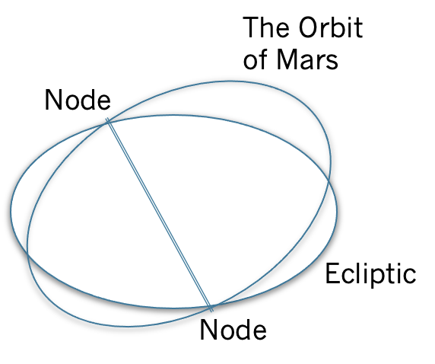
Non-coplanarity

Slide 43
Latitude Discrepancy
The angle between the observed and predicted latitudes is the discrepancy
Observed latitude
Latitude predicted by the orbit model
Mars’ position on its proposed orbit on its proposed plane
𝜹
Ecliptic
Mars’ orbital plane

Slide 44
So the Challenge
Non-circular orbit for Mars?
What other curves? Center/radius?
Non-circular orbit for Earth? Center? Same as Mars, or different?
Cadence model: If not Equant, then what?
Same for both Earth and Mars or different?
What intersection line between the ecliptic and Mars’ orbit plane?
What inclination between the two planes?
Find values for all the above parameters so as to minimize the max Oppositions Long. Discrepancy, Triangulations Long. Discrepancy and Oppositions Lat. Discrepancy

Slide 45
Kepler Leap 1: Generalizing Circles by Ellipses
Just differential stretching on the two orthogonal axes. The center is stretched apart into two so called foci, with e being the eccentricity
e .x
y
y
x
radius: y
Semi major axis: x

Slide 46
Kepler Leap 2: Eliminating the Equant
Instead of uniform angular speed around the Equant, equal areas in equal time around the Sun or the focus of the ellipse, or another point in the ellipse
The Sun appears to move slower, takes more time and covers a lesser area
The Sun appears to move faster, takes lesser time and covers a lesser area

Slide 47
The Full Problem: A Candidate Project
Major axis for Earth is 1AU
Elliptical Orbit for Earth, with arbitrary focus (f), major axis direction (d), eccentricity e
Line of intersection of Mars’ plane with the ecliptic (l)
Inclination of Mars’ plane relative to the ecliptic (i)
Elliptical orbit for Mars on its plane, with arbitrary focus (f’), major axis direction (d’), eccentricity e’
Major Axis for Mars (m)
The areal speed for Earth about its focus (s)
The areal speed for Mars about its focus (s’)
Find values for f, d, e, l, i, f’, d’, e’, m, s, s’ so as to minimize the max Oppositions Long. Discrepancy, Triangulations Long. Discrepancy and Oppositions Lat. Discrepancy
Remember all work on longitudes needs to be done by projecting Mars’ orbit on the ecliptic place

Slide 48
Narrowing Ranges
Earth’s eccentricity e is likely small (the analemma width) ~0.02
Earth’s focus (f) likely close to the Sun (from the previous circular fit) ~0.02
Earth’s major axis direction d unconstrained (0-365 deg)
Line of intersection of Mars’ plane with the ecliptic l: see next slide
Inclination of Mars’ plane relative to the ecliptic i: see next slide
Mars’ focus f: could constrain it to be the same as Earth’s
Major axis direction d’ roughly 328 degrees, from the previous circular fit
Major Axis for Mars m roughly 1.5AU from our previous circular fit
Eccentricity for Mars e’: roughly distance between center and sun in the circular fit divided by 1.5 AU
The areal speed for Earth about its focus s (~π/365)
The areal speed for Mars about its focus s’ (~π 2.25/687)

Slide 49
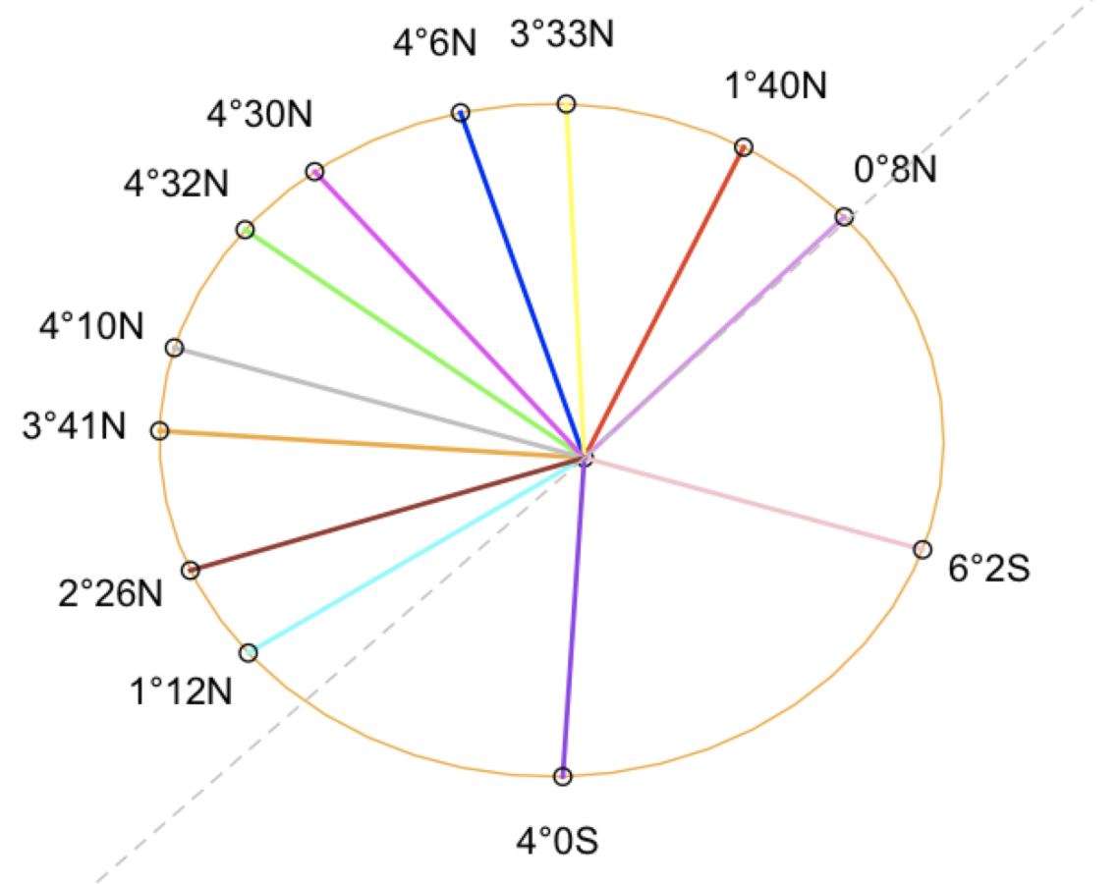
Non Coplanarity: Opposition Latitudes
Opposition latitudes are indicative of l and i
~4 deg
~2 deg
~0.5 AU
~1 AU

Slide 50
Ellipses Stay Ellipses on Projection
This will be convenient to switch between the ecliptic and Mars’ plane. How does one prove this?

Slide 51
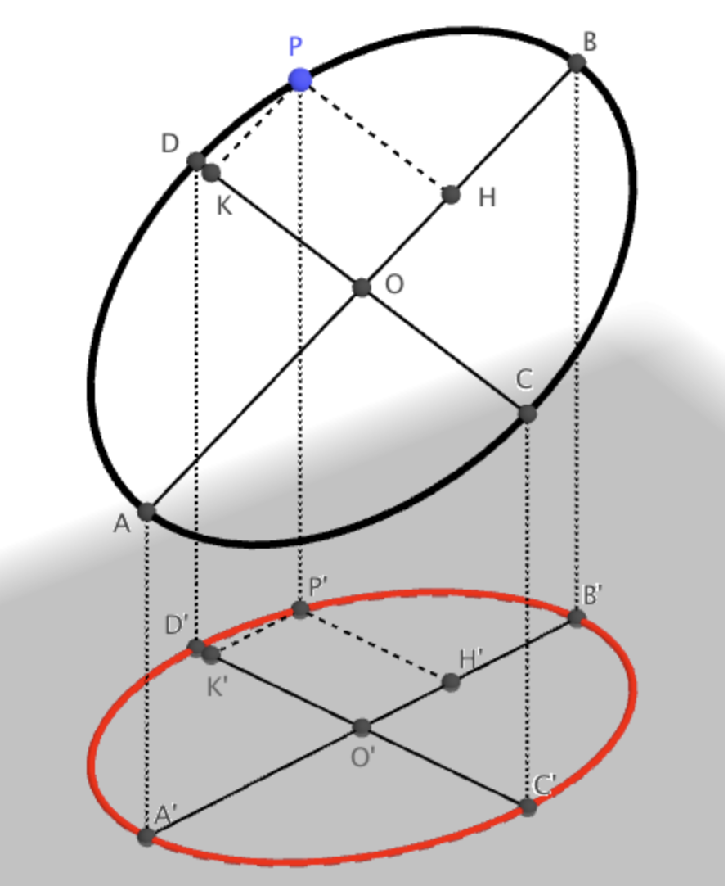
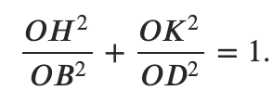
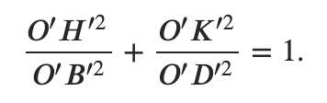
Ellipses Stay Ellipses on Projection
Proportions on a line are preserved on projection. There is a flaw though in this proof.
https://math.stackexchange.com/questions/3534227/the-projection-of-an-ellipse-is-still-an-ellipse

Slide 52
A Linear ALgebraic Proof
Consider an ellipse on the x-y plane with center at the origin that you want to project to another plane P
The ellipse has the form x^{T}A^{T}Ax=1
x and A are 2D but think of them as 3D with the z coordinate 0
If A is a diagonal matrix, this gives the conventional equation for the ellipse
A linear transformation Pz projects any given 3D point z to plane P
P not invertible in general (given Pz, z is not unique)
However z is unique on the x-y plane, so a pseudo-inverse P† exists relative to this plane
Then P†Px=x for x on the x-y plane
(x^{T}P^{T}P^{†T} ) A^{T}A (P†Px)=1
(Px)^{T} (AP†)^{T} (AP†) (Px) = 1
Hence the projected points Px form an ellipse
Note: above assumes plane P passes through the center, convince yourself that is ok

Slide 53
Optimization
Given a set of parameters
With range constraints on each parameter
And an objective function
Find values of all the parameters that minimize the objective function
So far, we have outlined a brute force grid search, with some intelligent narrowing down of parameter ranges
Are there better methods?

Slide 54
Greedy Descent
Start with an arbitrary valid assignment to the parameters
Repeatedly find a neighboring assignment that does better on the objective function and move to it
Where neighbors are defined as per the discretization of the range for each parameter
Typically tweak a single parameter at a time, perhaps go round robin over parameters
Could get stuck in local minima
Do we have any in our case? You can explore this in the project.

Slide 55
Simulated Annealing
How to jump out of local minima
Occasionally, allow movement to a neighboring assignment that is worse on the objective function
So if the neighbor is better, move to it
If the neighbor is worse, move to it with a probability that is proportional to exp( (currentValue - neighbourValue) /Temperature)
Of course, you will need to normalize the above
Initially, start with high temperature so the probability of accepting the move to a worse neighbor is high
As you get closer to the objective function becomes 4’, drop the temperature, so you start heading towards the current local minima
You will need to experiment with setting the initial temperature and the cooling schedule

Slide 56
Other Options: Gradient Descent
If you can write the objective function in a closed form and obtain the partial derivative for each parameter, the vector of partial derivative values is the gradient
Repeatedly move in that gradient direction by a certain step size
Small step sizes take time, bigger step sizes overshoot the local minimum
Often use convex approximations in the local neighborhood to get to the local minimum of this approximated function in one shot
Is gradient descent applicable here? Explore in the project

Slide 57
Newton and Gravitation
Several decades later, Newton tried to explain the physics of ellipses and of equal areas in equal time
He had to come up with a few tools for this
Orthogonal decomposition: write a vector as a sum of two orthogonal vectors
Define Force as vector that changes the velocity (and not the position directly)
Calculus to handle continuously varying quantities

Slide 58
Equal Areas in Equal Time
It follows that the rate of change of areas is a constant; also known as the conservation of angular momentum; holds regardless of a gravitational law
Area traversed in this infinitesimal time step is
0.5 r v sin𝛳 dt
Area traversed in the next step is
0.5 sqrt[ (r - v cos𝛳 dt) ²+ (v sin𝛳 dt)² ]
[ (v cos𝛳+a dt ) sin d𝛅 + v sin𝛳 cos d𝛅 ] dt
r’
v dt
𝛳
d𝛅
r

Slide 59
Speed and Energy
This is the familiar law of conservation of energy
Speed square v²
Speed square after the infinitesimal time step (v cos𝛳+a dt)² + (v sin𝛳)²
Difference 2 a vcos𝛳 dt = 2 a dr
Integrating v²-v₀² = 2 ∫a dr
Where v₀² is the initial speed squared
And the integration is from the initial r₀ to the current r
If a=O(1)/r² then v²-v₀² = 2 (O(1)/r - O(1)/r₀)
v dt
𝛳
d𝛅
r

Slide 60
Leading up to the Ellipse..
So we have r in terms of 𝛅; what curve does the integration suggest?
v²=v₀² +2 (1/r - 1/r₀)=O(1)+O(1)/r
Vertical component of velocity is O(1)/r on account of equal areas in equal time
Horizontal component squared is therefore O(1)+O(1)/r-O(1)/r²
d𝛅 = O(1)/r dt /r
dr = sqrt [O(1)+O(1)/r-O(1)/r²] dt
d𝛅 = O(1) dr / r² sqrt [O(1)+O(1)/r-O(1)/r²]
O(1)/r dt
𝛳
d𝛅
r

Slide 61
And the Ellipse..
This happens only when the radial acceleration a=O(1)/r²
The polar form of an ellipse with resp to the focus
cos 𝛅 = 1/e (a/r -1)
r = a/ (1 + e cos 𝛅)
The numerator a is the latus rectum
e is the eccentricity
r
𝛅

